Slide 1
RNAseq Data Analysis
MSU Workshop
Rama Shankar
ramashan@msu.edu

Slide 2
Outline
Introduction of RNAseq
RNA isolation and library preparation
RNAseq data analysis
Demo of RNAseq data analysis on MSU HPCC

Slide 3
I. Introduction of RNAseq

Slide 4
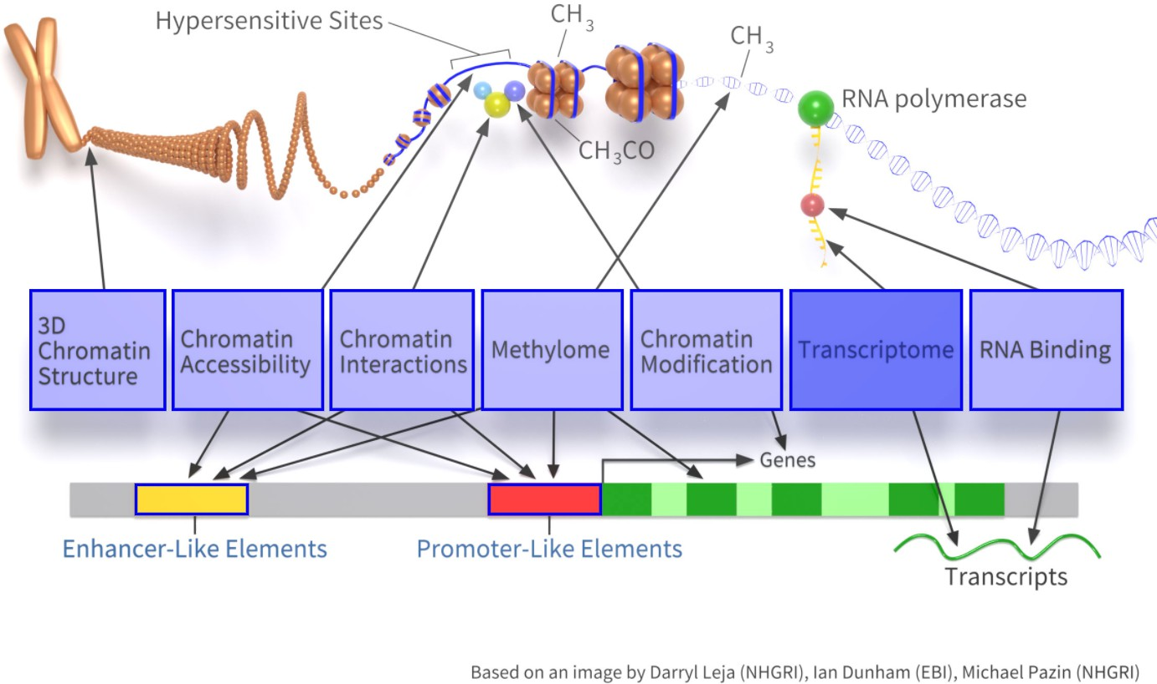
Probing cells with sequencing technologies
Hi-C
ATAC-seq DNase-seq
Bisulfite-seq
Chip-seq
RNAseq
CLIP-seq

Slide 5
Types of RNA
mRNA
lncRNA (long non-coding RNA)
microRNA (small RNAseq)
Circular RNA
rRNA
tRNA
snoRNA piRNA

Slide 6
II. RNA isolation and library preparation

Slide 7
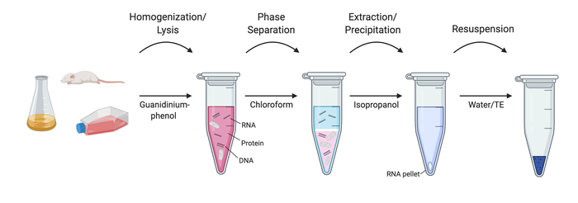
RNA isolation
https://www.addgene.org/protocols/kit-free-rna-extraction/

Slide 8
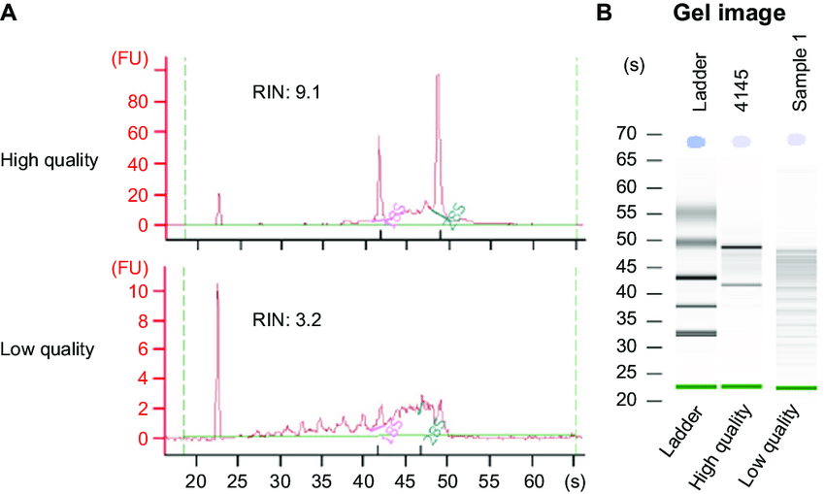
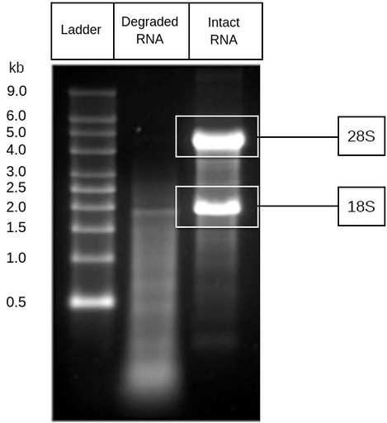
Quality check of RNA

Slide 9
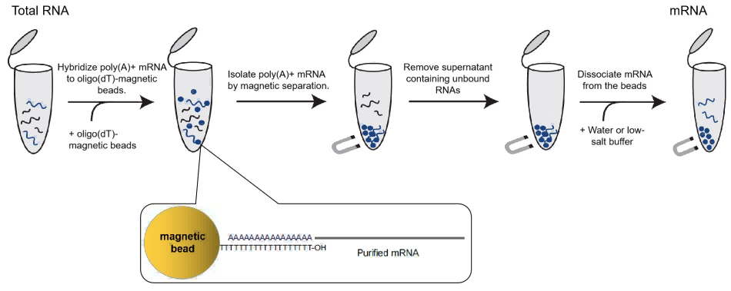
mRNA enrichment using poly dT beads
https://www.yeasenbiotech.com/solutiondetail/94

Slide 10
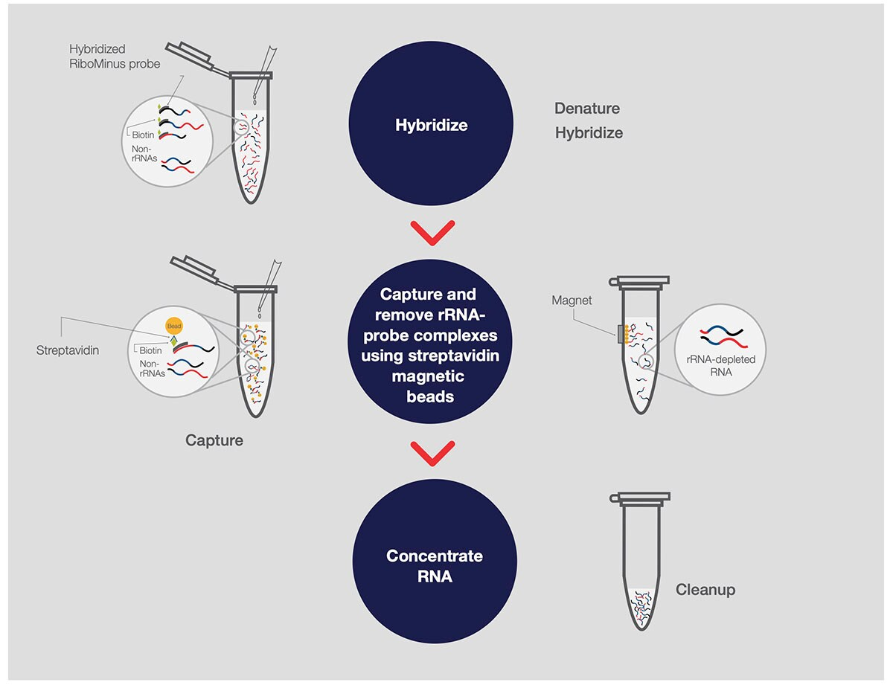
mRNA enrichment using ribosomal RNA depletion

Slide 11
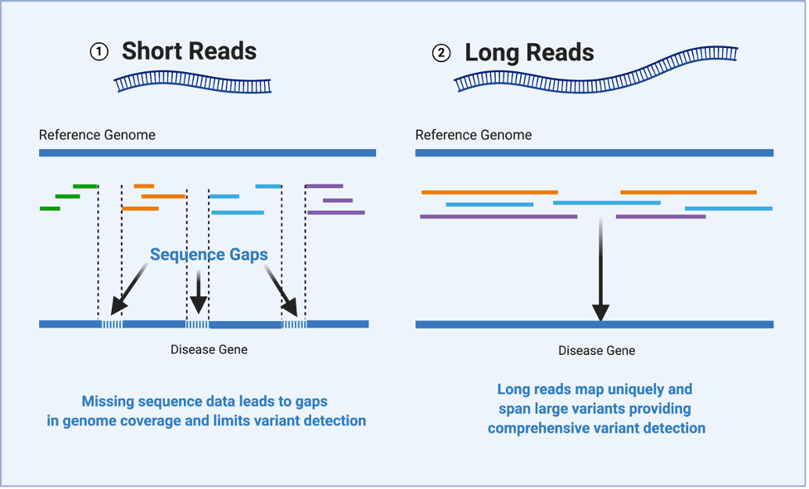
Short reads vs long reads

Slide 12
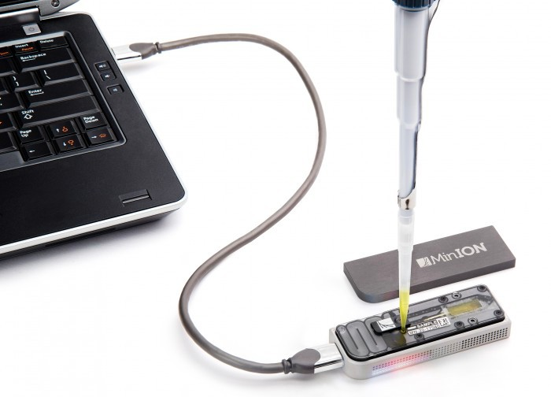
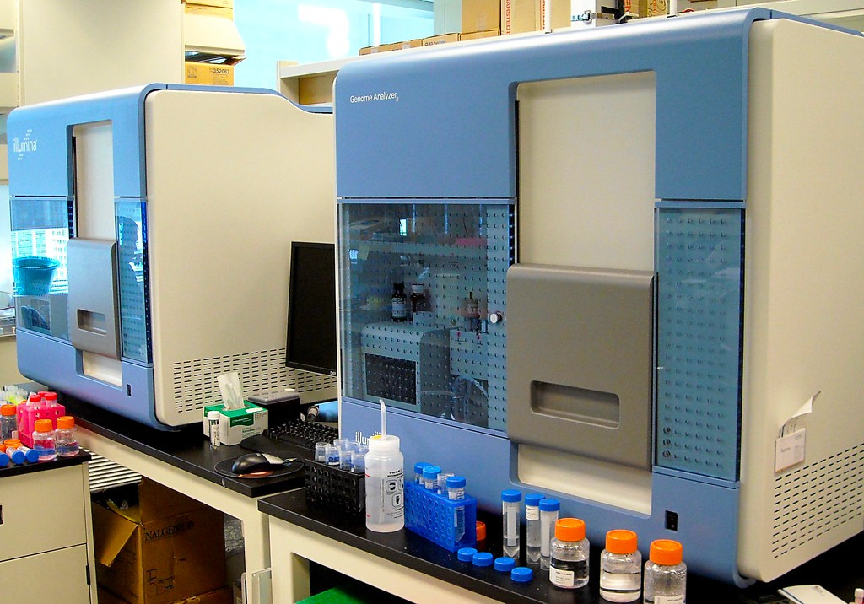
Long read vs short read platforms
Oxford Nanopore (long read)
Illumina genome analyzer (short read)

Slide 13
IIA. From RNA to long reads

Slide 14
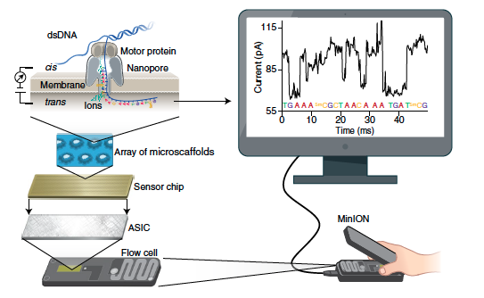
Principle of Nanopore sequencing
https://www.nature.com/articles/s41587-021-01108-x

Slide 15
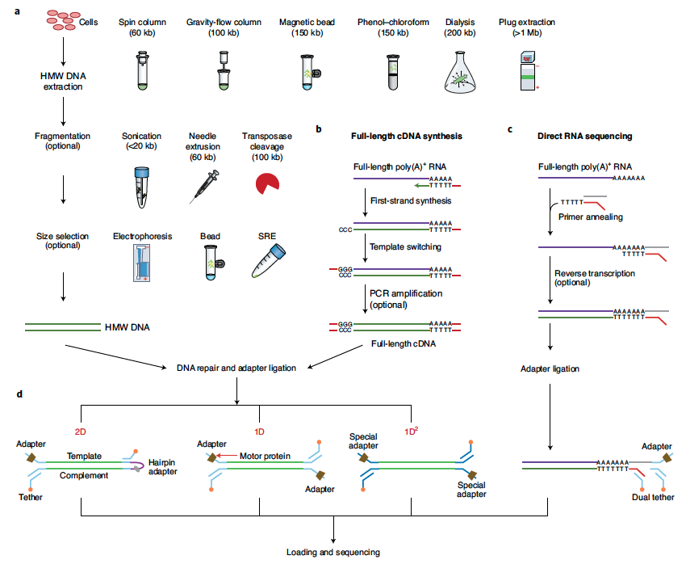
Library preparation and sequencing workflow for Nanopore
2D (template strand is sequenced), 1D (where each strand is ligated with an adapter and sequenced independently) and 1D² (special adapter ligated to sequence one followed by another one)

Slide 16
IIB. From RNA to short reads

Slide 17
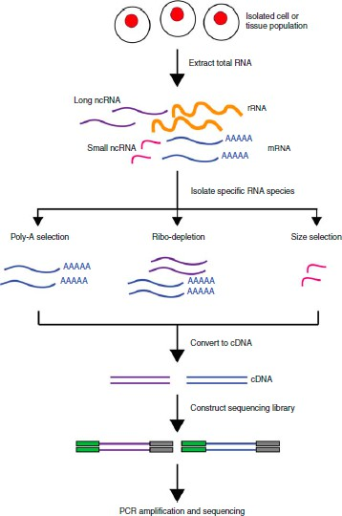
RNAseq library construction for Illumina (short reads)
(using fragmentated RNA)
adapter
Insert size
https://www.rna-seqblog.com/introduction-to-rna-sequencing-and-analysis/

Slide 18
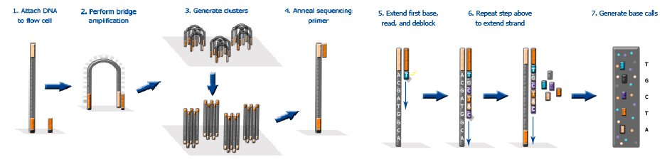
Overview of Illumina sequencing
Sequencing by Synthesis
Picture is from https://www.eurofinsgenomics.co.in/en/eurofins-genomics/product-faqs/next-generation-sequencing/general-technical-questions/what-is-the-principal-of-the-illumina- sequencing-technology.aspx
https://www.illumina.com/documents/products/techspotlights/techspotlight_sequencing.pdf (Documentation from illumina) https://www.youtube.com/watch?v=fCd6B5HRaZ8

Slide 19

Strandness matters
DNA is double-stranded, both strand could be transcribed.
TGCCCAG ACGGGTC
cDNA
Strand 1
Strand 2
5’- ATGCTTGAATTGCCCAGGTTACTAGCTTAGC-3’
3’- TACGAACTTAACGGGTCCAATGATCGAATCG-5’
If an RNA fragment comes from the dashed region, it is hard to know its original gene without strand information.

Slide 20
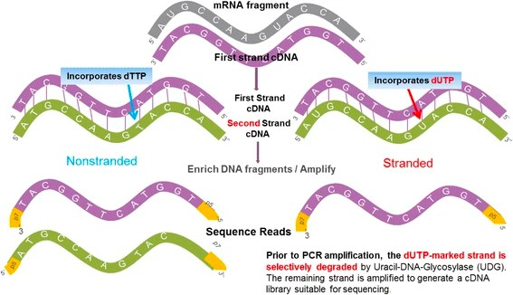
Nonstranded vs Stranded library
(recommended)
Ref: Zhao et al. Comparison of stranded and non-stranded RNA-seq transcriptome profiling and investigation of gene overlap. (BMC Genomics, 2015)

Slide 21
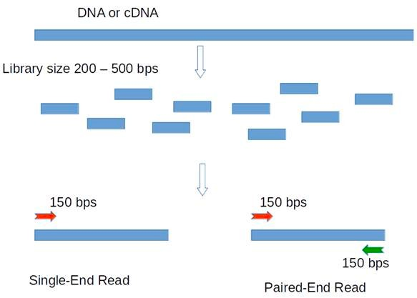
Single-end vs Paired-end
3’
5’

Slide 22
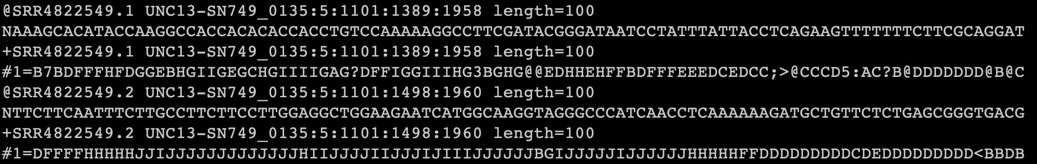
Output of RNAseq
According to sequencing mode, single-end or paired-end read.
Typical read length: 50bp, 75bp, 100bp.
Reads are usually stored in FASTQ format.

Slide 23
Preparation of RNAseq experiments
Sequencing depth (library size): deeper is better! Usually > 20 million reads should be OK (from illumina).
Stranded vs Non-stranded: Strand-specific is recommended.
SE vs PE: consider PE if you have enough budget. For gene expression analysis, SE also works well.
Technical replicates, the more the better (at least three) .
Longer read length is better.

Slide 24
Q&A

Slide 25
III. RNAseq data analysis

Slide 26
RNA-seq data analysis
Data quality checking.
Read mapping.
Quantification of gene expression.
Differential gene expression analysis.
Interpretation of DE analysis results.

Slide 27
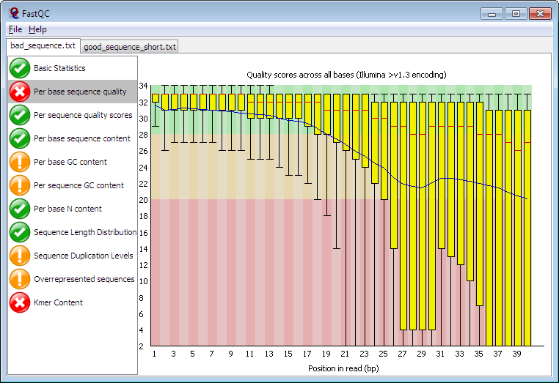
Quality check of reads using FastQC

Slide 28
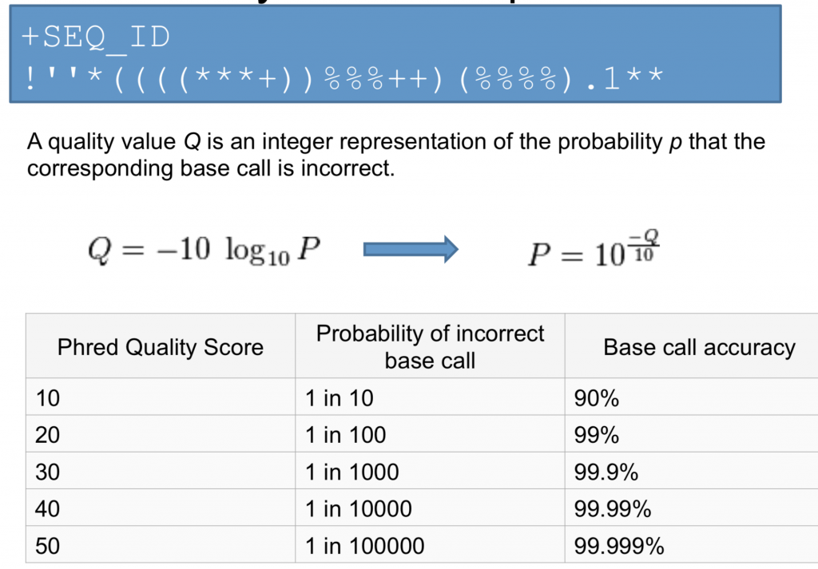
Phred quality score

Slide 29
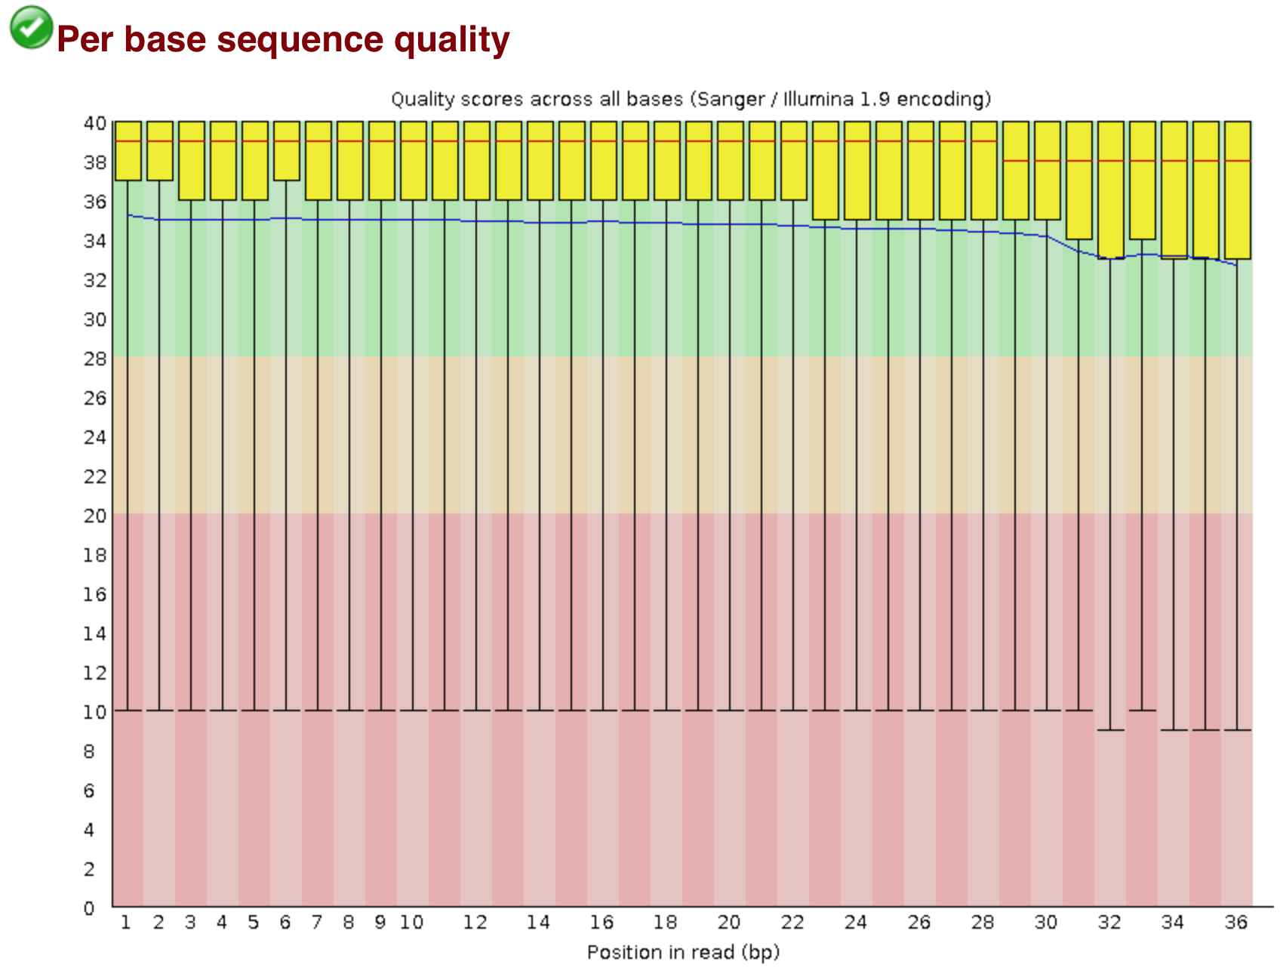
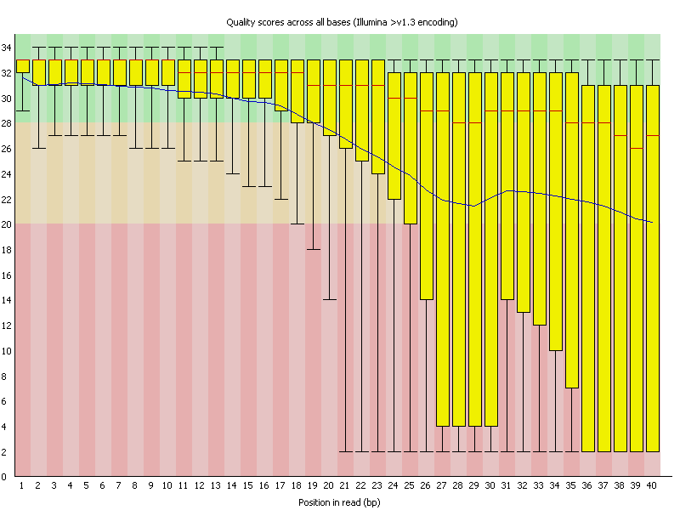
Good and bad quality of sequencing reads

Slide 30
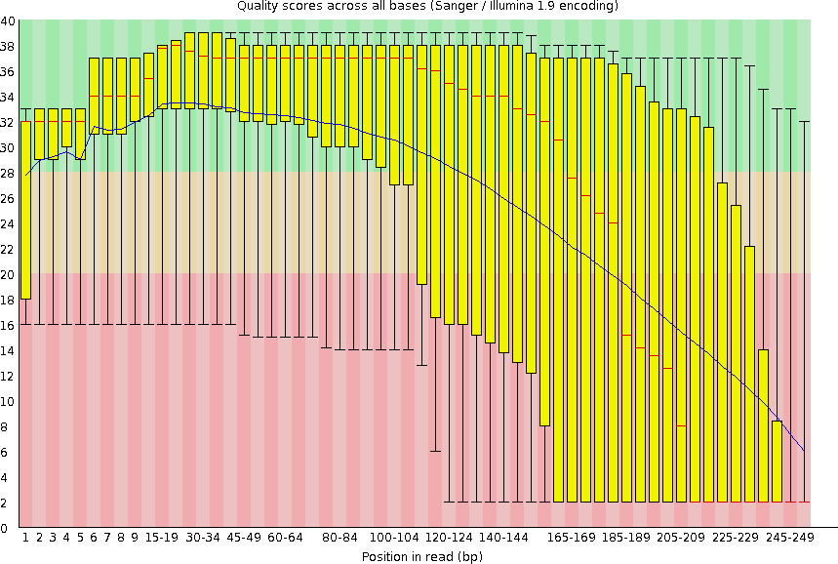
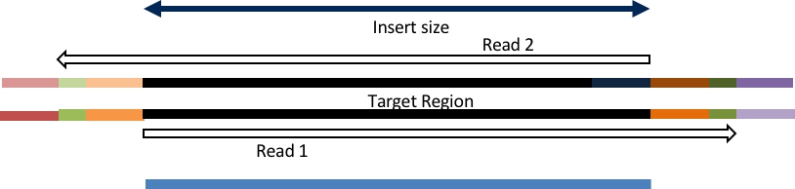
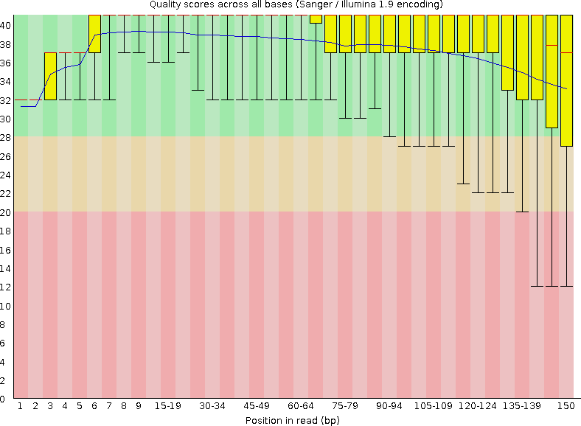
Data quality checking and removing the contaminations
RNAseq reads quality
Adapter removal
Insert size < read length
Trimming the reads
For paired end: Bbduk, Skewer, HTStream, and FASTP
For single end: Cutadapt, HTStream, and BBduk

Slide 31
Software for data quality checking
We use fastqc to run data quality checking.
Available at
https://www.bioinformatics.babraham.ac.uk/projects/fastqc/
fastqc xx.fastq

Slide 32
Tools used for long reads mapping
Minimap2
LAST
NGMLR
GraphMap
https://www.nature.com/articles/s41587-021-01108-x

Slide 33
Tools used for short reads mapping
STAR (Spliced Transcripts Alignment to a Reference)
Kallisto
BWA (Burrows-Wheeler Aligner)

Slide 34
Read mapping (single-end)
The process to align short RNAseq reads with the genome (transcriptome) sequence.
Alignment
Gene1
Gene2
Genome

Slide 35
Read mapping (paired-end)
Alignment
Gene1
Gene2
X
Genome

Slide 36
Quantification of gene expression (raw read count)
Gene1
Gene2
Genome
Expression of | Gene1: | 3
Expression of | Gene2: | 4

Slide 37
Problem of raw read count
NOT comparable between different experiments (library size matters).
NOT comparable between different genes (gene length matters).
Raw-read-count is proportional to library.size * gene.length,
normalization is needed!
Rep1 (library size = 7)
Gene1
Gene2
Genome
Rep2 (library size = 14)
Gene1
Genome
Gene2

Slide 38
Quantification of gene expression (RPKM and FPKM)
RPKM: FPKM:
Reads Per Kilobase Per million mapped reads (single-end). Fragments Per Kilobase Per million mapped reads (paired-end).
C = Number of reads (fragments) mapped to a gene N = Total number of mapped reads (fragments) in the experiment
L = Exon length in base-pairs for a gene
RPKM = (10^9 * C) / (N * L)

Slide 39
Problem of RPKM (FPKM)
AAAA
AAAA
AAAA
AAAA
AAAA
AAAA
AAAA
AAAA
AAAA
AAAA
AAAA
AAAA
Gene1 Gene2
E₁ = (4 / 6 )
E₂ = (2 / 6 )

Slide 40
Isoform matters
AAAA
AAAA
AAAA
AAAA
AAAA
AAAA
AAAA
AAAA
AAAA
AAAA
AAAA
AAAA
Exp1
Exp2
rl: read length RNAseq experiment Lp: isoform length (purple)
Lr: isoform length (red, exp1) Lrs: isoform length (red, exp2)
Suppose we want to compute RPKM for the purple gene
RPKM = (10^9 * C)/(N * L) = 10^9 * (C / N ) * (1 / L)
C = Number of reads mapped to a gene
N = Total number of mapped reads in the experiment L = Exon length in base-pairs for a gene
P1 = Lp * 2 / rl P2 = Lp * 2 / rl
R1 = Lr * 4 / rl R2 = Lrs * 4 / rl
RPKM1 = 10^9 * ( P1/(P1+R1) ) * 1 / Lp RPKM2 = 10^9 * ( P2/(P2+R2) ) * 1 / Lp
C / N: proportion of reads coming from a gene

Slide 41
Quantification of gene expression (TPM)
TPM: Transcripts Per Million.
Given a Gene Gi, compute T_{i} = C_{i} / L_{i}
C_{i} : Number of reads mapped to the gene L_{i}: Exon length in base-pairs for the gene
TPM_{i} = 10^6 * T_{i} / (T₁ + T₂ + ….. T_{n})
Wagner et al. Measurement of mRNA abundance using RNA-seq data: RPKM measure is inconsistent among samples.

Slide 42
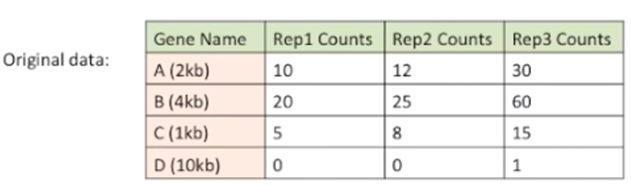
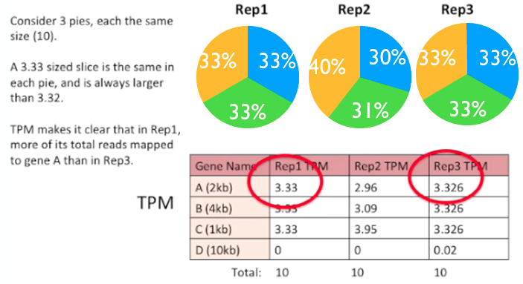
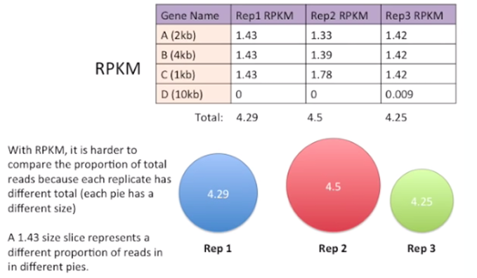
TPM vs RPKM

Slide 43
Relationship between RPKM (FPKM) and TPM
TPM_{i}
= RPKM_{i} / Sum (RPKM)
Ref: https://rnajournal.cshlp.org/content/early/2020/04/13/rna.074922.120.full.pdf

Slide 44
Core analysis
Data quality checking.
Read mapping.
Quantification of gene expression.
Differential gene expression analysis (R).
Interpretation of DE analysis results.

Slide 45
Data quality checking
We use fastqc to run data quality checking.
Available at
https://www.bioinformatics.babraham.ac.uk/projects/fastqc/
fastqc xx.fastq

Slide 46
Quantification of gene expression
RNAseq reads (FASTQ)
The alignment process is time-consuming!
We can get the read count for gene, but NOT for isoforms!
Reads ambiguity not solved well.
Align to genome (Tophat, STAR, HISAT2)
BAM files
Genome
Gene1
Gene2
read count matrix (featureCounts, HTSeq)

Slide 47
Quantification of gene expression
RNAseq reads (FASTQ)
RNAseq reads (FASTQ)
Align to transcriptome (STAR)
Align to transcriptome (Kallisto, Salmon)
BAM files
read count, tpm
(isoforms)
RSEM
read count, fpkm, tpm
(genes and isoforms)

Slide 48
Quantification of gene expression
RNAseq reads (FASTQ)
Read mapping
Align to transcriptome (STAR)
STAR genome index
STAR
Genome sequence file Genome annotation file
BAM files
Quantification
RSEM
RSEM transcriptome index
RSEM
read count, fpkm, tpm (genes and isoforms)

Slide 49
Preparation of index files
Genome sequence (from NCBI): ftp://ftp.ncbi.nlm.nih.gov/genomes/archive/old_genbank/Eukaryotes/vertebrates_mammals/Homo_sapiens/GRCh38/seqs_for_alig nment_pipelines/GCA_000001405.15_GRCh38_no_alt_analysis_set.fna.gz
Genome annotation file (from GENCODE): ftp://ftp.ebi.ac.uk/pub/databases/gencode/Gencode_human/release_23/gencode.v23.annotation.gtf.gz
STAR --runThreadN 32 \
--runMode genomeGenerate \
--genomeDir STAR.index \
--genomeFastaFiles GCA_000001405.15_GRCh38_no_alt_analysis_set.fna \
--sjdbGTFfile gencode.v23.annotation.gtf
rsem-prepare-reference -p 4
--gtf
gencode.v23.annotation.gtf GCA_000001405.15_GRCh38_no_alt_analysis_set.fna RSEM.index/hg38.RSEM.index

Slide 50
Code to run the mapping using STAR aligner
STAR --genomeDir /ensembl38_STAR_index/
--runThreadN 6 \
--readFilesIn Mov10_oe_R1.subset.fq Mov10_oe_R2.subset.fq \
--outFileNamePrefix ../results/STAR/Mov10_oe_1_ \
--outSAMtype BAM SortedByCoordinate \
--outSAMunmapped Within \
--outSAMattributes Standard

Slide 51
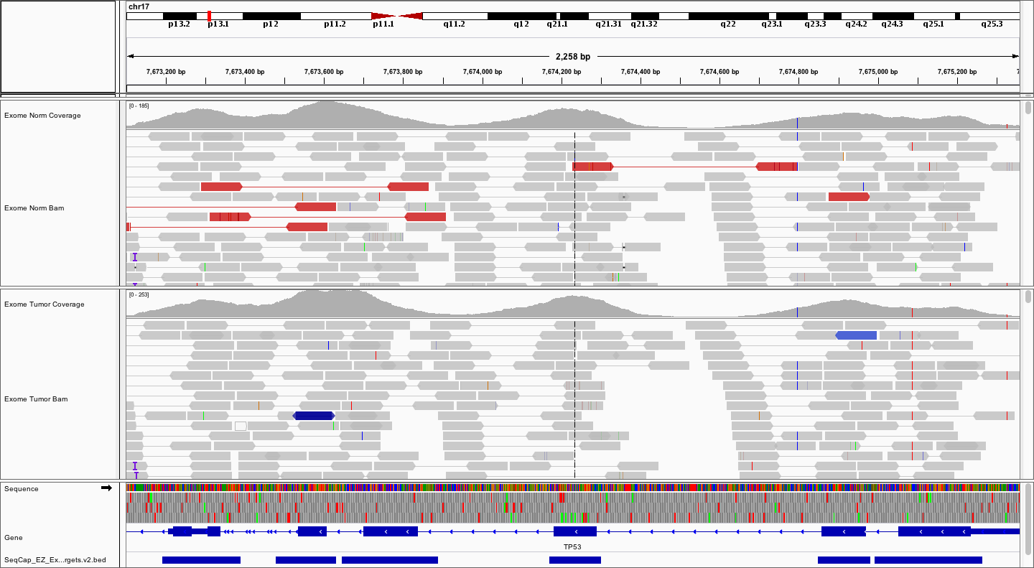
STAR aligner output

Slide 52
Quantify the read count, TPM, and FPKM
Rsem-calculate-expression \
--no-bam-output \
--quiet \
--no-qualities \
-p 8 \
--seed-length 25 \
--bam \
--paired-end tmp/sample/Aligned.toTranscriptome.out.bam \
$RSEM_INDEX \
RSEM.output/sample.txt

Slide 53
RSEM-gene-count output

Slide 54
Q&A

Slide 55
III. Demo of RNAseq data analysis on MSU HPCC

Slide 56

Starting OnDemand on HPCC
https://ondemand.hpcc.msu.edu/

Slide 57
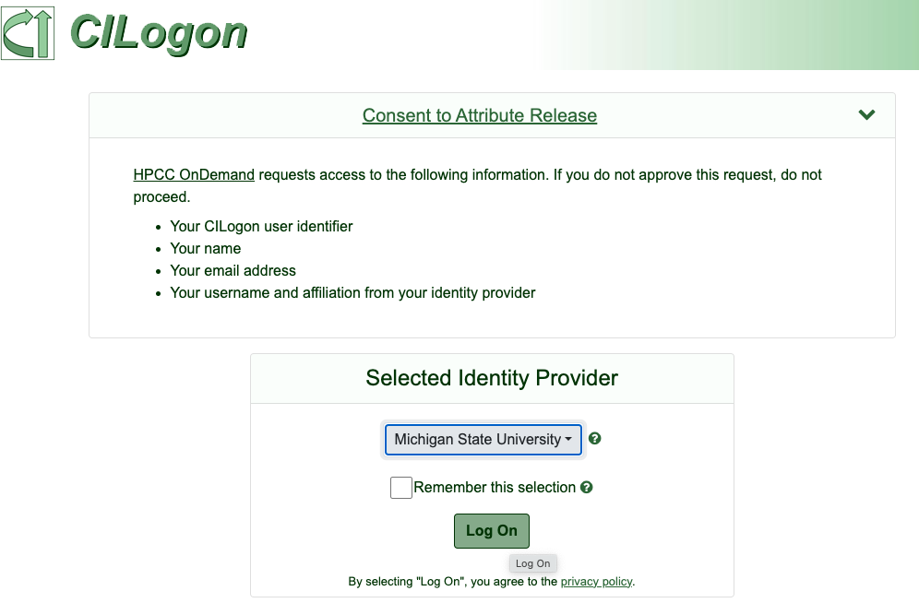
Login on OnDemand HPCC

Slide 58
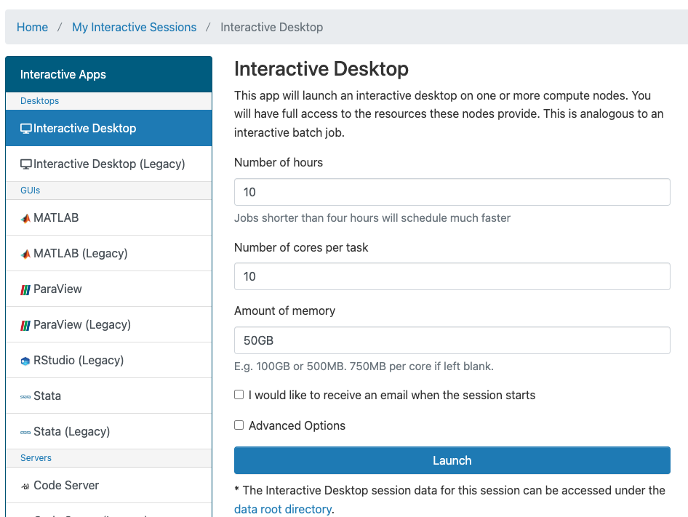
Request to start Interactive Desktop

Slide 59
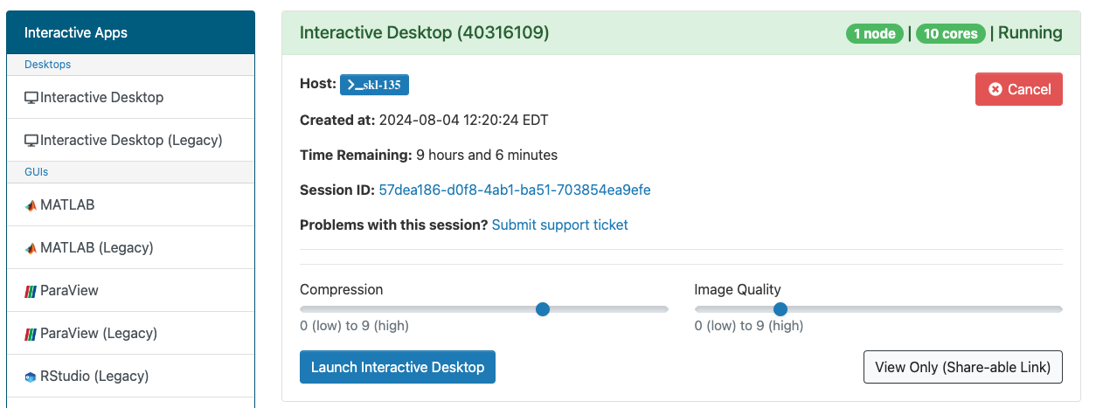
Lunch Interactive Desktop on HPCC

Slide 60

Access terminal on Interactive Desktop

Slide 61
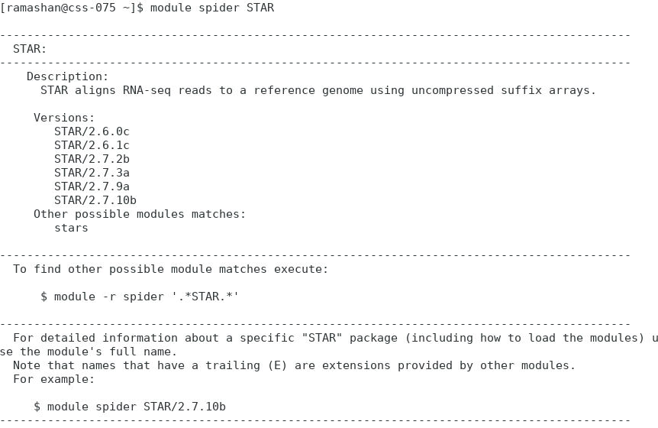
Available versions of STAR package on HPCC

Slide 62
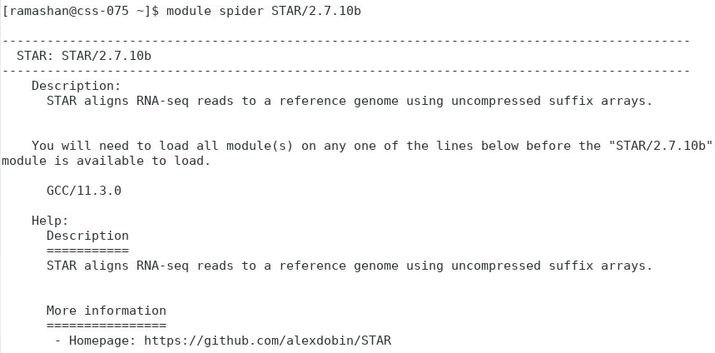
Loading of STAR package on HPCC
[ramashan@css-075 ~]$ module purge
[ramashan@css-075 ~]$ module load GCC/11.3.0 STAR/2.7.10b

Slide 63
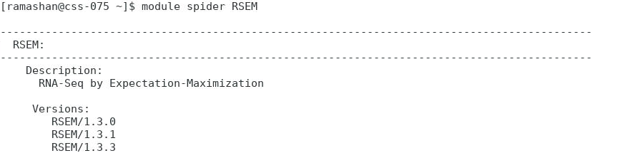
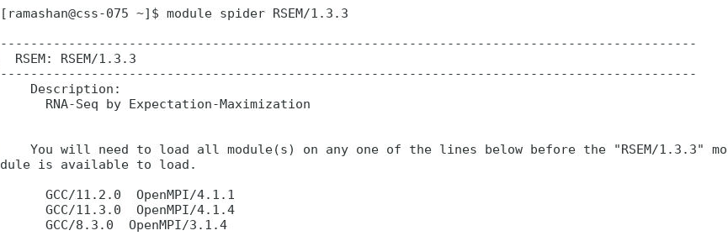
Loading of RSEM package on HPCC
[ramashan@css-075 ~]$ module load GCC/11.3.0 OpenMPI/4.1.4 RSEM/1.3.3

Slide 64
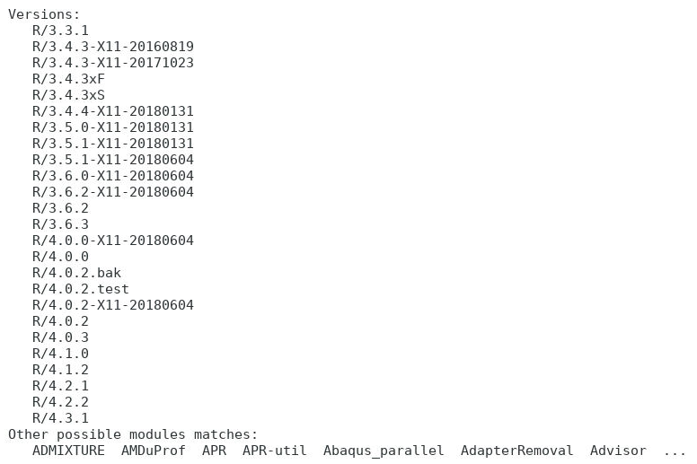
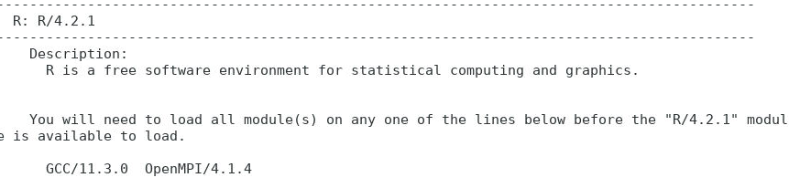
Loading R on HPCC
[ramashan@css-075 ~]$ module spider R
[ramashan@css-075 ~]$ module spider R/4.2.1
[ramashan@css-075 ~]$ module load GCC/11.3.0 OpenMPI/4.1.4 R/4.2.1

Slide 65
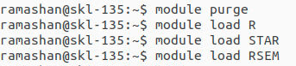
Loading the packages with the new OS on HPCC

Slide 66
Test the loaded module
ramashan@dev-amd20-v100:~/data/RNASeq_test$ STAR
Usage: STAR [options]... --genomeDir /path/to/genome/index/ \
--readFilesIn R1.fq R2.fq
Spliced Transcripts Alignment to a Reference (c) Alexander Dobin, 2009-2022
STAR version=2.7.11b
STAR compilation time,server,dir=2024-07-18T13:18:20-04:00 dev-intel14:/tmp/
panchyni/easybuild/easybuild/build/STAR/2.7.11b/GCC-13.2.0/STAR-2.7.11b/source
For more details see:
<https://github.com/alexdobin/STAR>
<https://github.com/alexdobin/STAR/blob/master/doc/STARmanual.pdf>
To list all parameters, run STAR --help

Slide 67
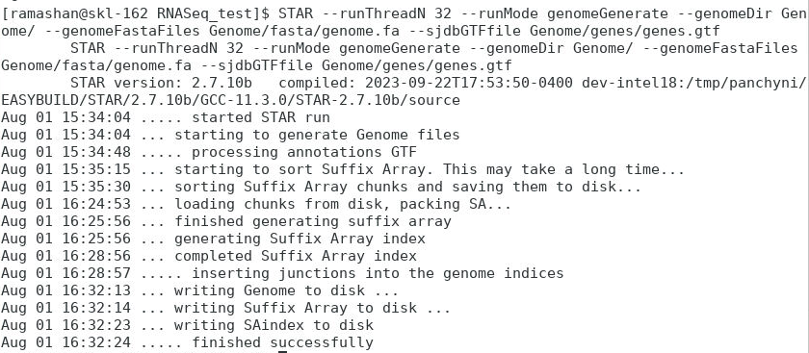
Create reference index file for STAR and RSEM
[ramashan@css-075 ~]$ rsem-prepare-reference -p 4 --gtf Genome/genes/genes.gtf Genome/fasta/Genome.fa hg38

Slide 68
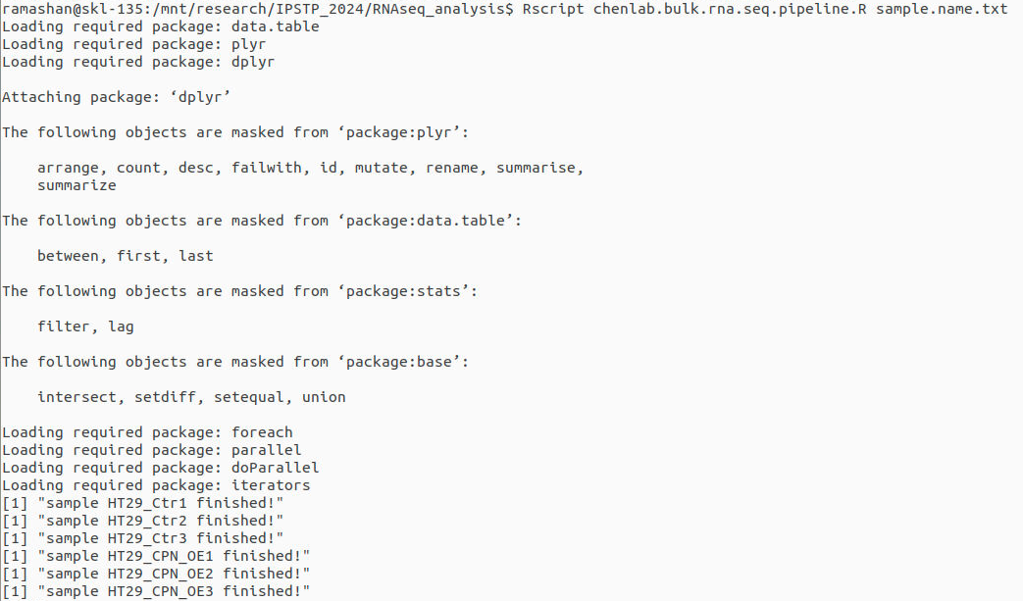
Running bulk.rna.seq.pipeline.R to process the samples

Slide 69
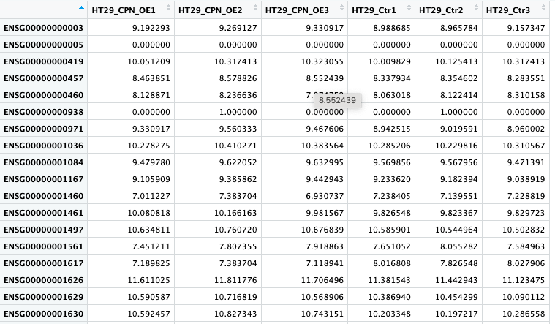
Raw read count in processed samples

Slide 70
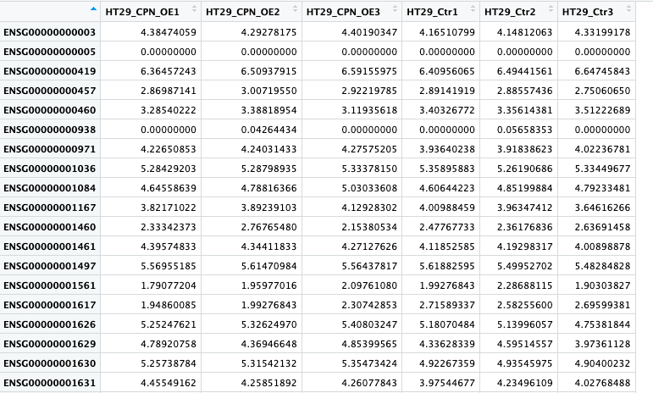
FPKM values in processed samples
* Data was paired end

Slide 71
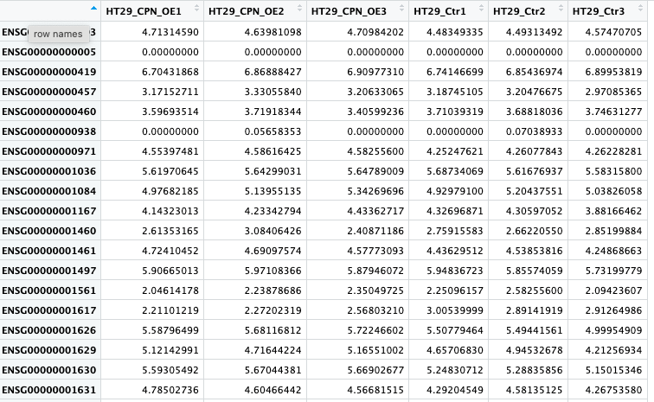
TPM values in processed samples

Slide 72
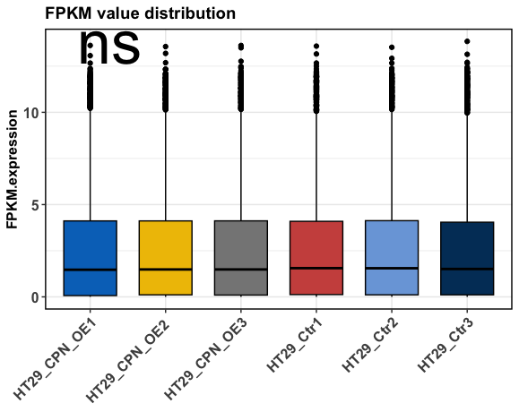
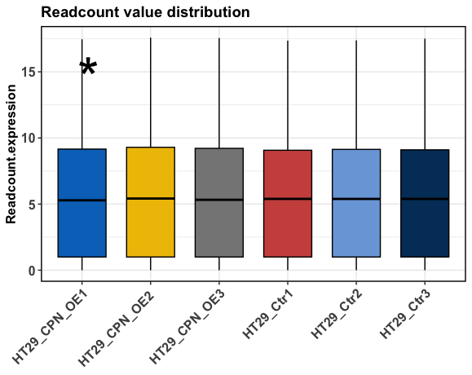
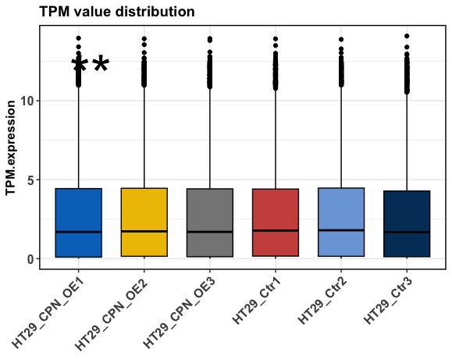
Visualization of raw read count, FPKM, and TPM

Slide 73
Take-home message
Know your RNAseq library clearly (SE or PE, Stranded or Non- stranded).
Three gene expression quantification measurements (raw-read-count, RPKM (FPKM), TPM).

Slide 74
Resources

Slide 75
Resources
Wang et al. RNA-Seq: a revolutionary tool for transcriptomics. (Nature Reviews Genetics).
Ana et al. A survey of best practices for RNA-seq data analysis (Genome Biology).
Lior Pachter’s blog (https://liorpachter.wordpress.com/).
RNASeq blog (https://www.rna-seqblog.com/).

Slide 76
Thank you
Q & A

